Slide 1

B A R T R.
TEAM BROGRAMMERS
BHARATH M K
CHANDAN SHENOY
AVINASH PRABHU
CALVIN PINTO

Slide 2
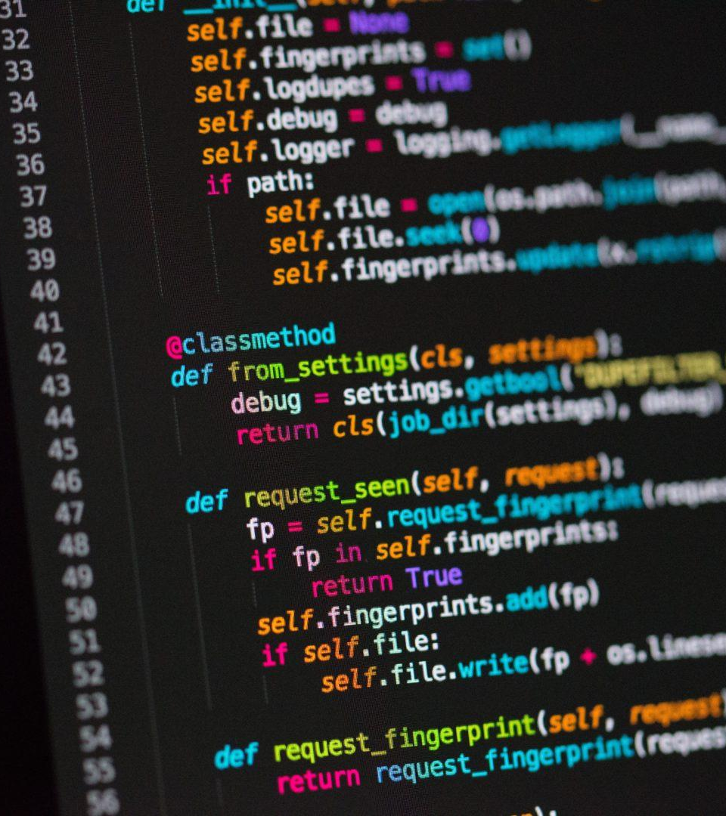
AGENDA
INTRODUCTION
BARTER SYSTEM
INTRODUCING BARTR.
COMBINATIONAL DIFFERENCES
USE-CASE

Slide 3
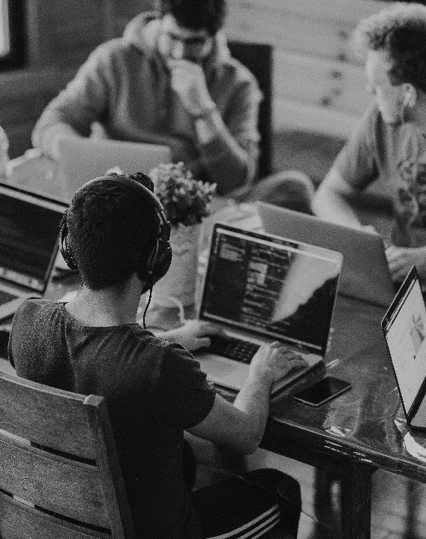
BRIEF INTRODUCTION
The world of finance today, is heavily centered on money, and we are here to make a difference. Re-introducing the good old Barter system to the 21st century. We intend to create an online platform for people to trade goods for goods or services for services. We believe that the value of goods and services should not be measured with only MONEY and that this non-money centric approach to trade can disrupt the world of finance for the good.

Slide 4
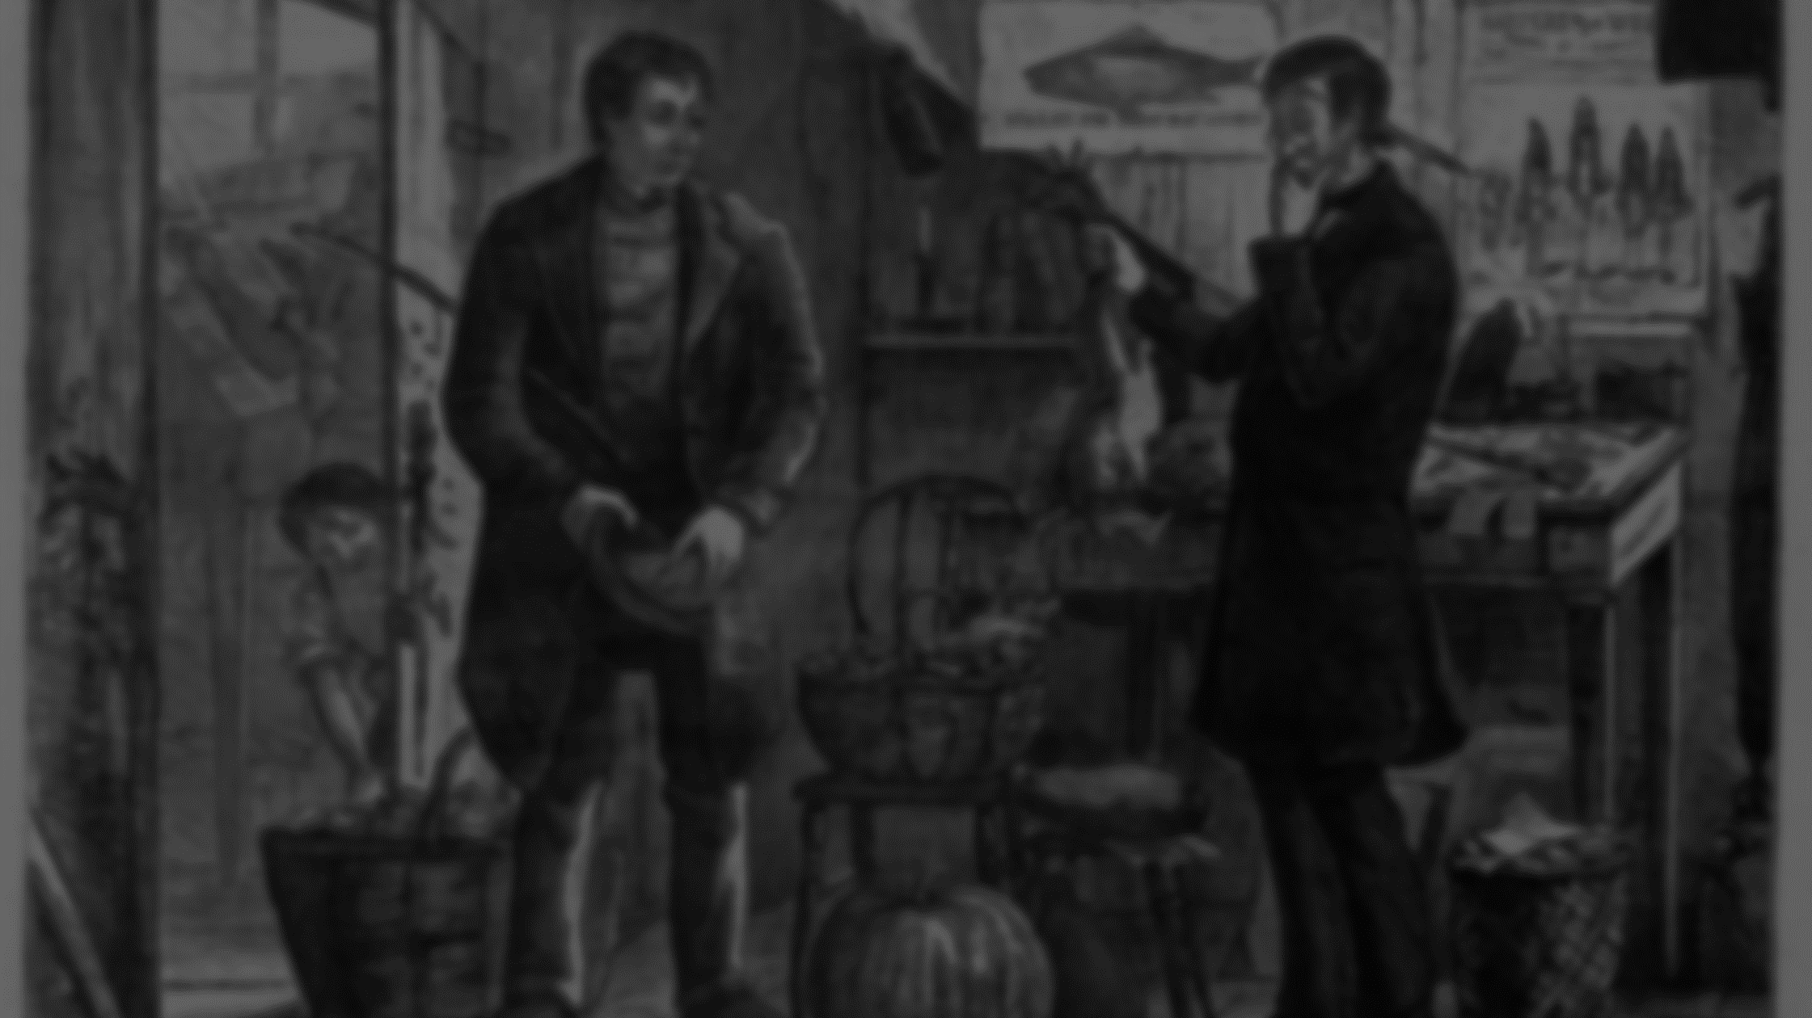
WHAT IS BARTER SYSTEM?
A barter system is an old method of exchange. This system has been used for centuries and long before money was invented. People exchanged services and goods for other services and goods in return.

Slide 5
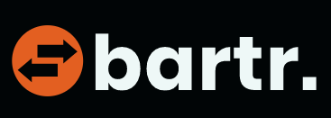
INTRODUCING BARTR.
Bartr is an online marketplace for goods and services in exchange for goods and services. The site provides a platform for people with similar trade interests to interact with each other and negotiate deals. The main driving feature of the site is that there is no money involved in the transaction and it is purely on the basis of the decision between the two users.

Slide 6
TRADITIONAL SYSTEM OF TRADE TODAY
Value in terms
of
Goods
Goods
Value in terms
of
G1
G1
g1
G2
G2
g2
G3
.
.
.
.
Money
G3
g3
.
.
.
.
.
.
.
.
G n
G n
g m

Slide 7


USE-CASE - 1
Consider an engineering student that has just entered the freshman year of college. He is in dire need of engineering text-books ,but they are known to be costly. He is also an avid reader of classic fiction and has several novels. On the other hand, consider an engineer who has just graduated from engineering and is in need of novels, during his time off. He has an excess of engineering text books which he does not need to use anymore.

Slide 8


Instead of purchasing a new novel, these users can trade these items saving them both money. Bartr finds another user depending on the requirements set and initiates an interactive panel between both users, in which they can engage in conversation and finalize the exchange on both the parties agreement.

Slide 9


USE-CASE - 2
Consider an owner of a small restaurant needs to make a website for his business and he does not want to pay for it. Instead he can use Bartr to trade for a web development service from a student living nearby in a PG in exchange for food from his own restaurant. Exchanging goods with services is also another possibility.

Slide 10
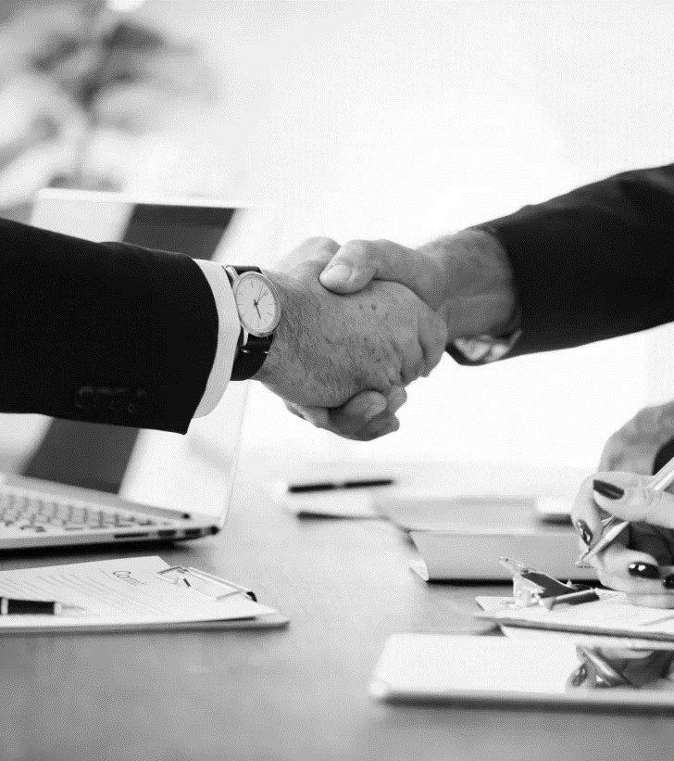
ADVANTAGES
Extremely useful for people who cannot afford to pay money for various goods and services.
Reduction in people discarding or wasting goods.
Satisfactory exchange between both parties.
No limit to the size of the exchange or type of goods/services exchanged.

Slide 11
THANK YOU

